Slide 1
LP201 Practicum for Innovative Engineering Design Presentation Report
Smart Street Light Project
Team Number: 10
College Name: PSVP Engi College
Date of submission:
S. No. | Student Name | Roll # | Year of Study | Department
1 | KAVIN PRASANNA K | 411723205023 | II | IT
2 | KAVIYA K | 411723205024 | II | IT
3 | ANUSHA M | 411723205005 | II | IT
4 | VIVEKA M | 411723106089 | II | ECE
5 | SHREEDHAR G | 411723106078 | II | ECE
S. No. | Faculty Name | Department
1. | Velusudha | ECE

Slide 2
Outline
Problem Statement
Designs options
Selected Design
Block Diagram
Bill of Material and Cost estimates
Gantt Chart – Project Plan
Open Issues
References

Slide 3
Problem Statement and Product
Problem statement
Traditional street lighting systems operate continuously at full brightness, resulting in excessive energy consumption and higher maintenance costs. These systems lack adaptability to environmental conditions, often remaining on during bright daylight or at full intensity when no pedestrians or vehicles are present. This inefficiency not only wastes energy but also contributes to unnecessary expenses. The need for a smarter solution arises, where lights can automatically adjust their brightness based on ambient light levels and movement detection, ensuring energy savings without compromising safety and visibility.
Disciplines involved
This project involves Electrical Engineering for power management, Electronics Engineering for sensor integration, Computer Science for programming and IoT integration, Mechanical Engineering for structural design, Civil Engineering for installation planning, and Environmental Science for energy efficiency.

Slide 4
Design options
Design option 1-Basic Sensor-Based System:
Uses an LDR (Light Dependent Resistor) for ambient light detection.
PIR (Passive Infrared) or ultrasonic sensors detect movement.
Simple microcontroller (e.g., Arduino) controls brightness levels.
Low-cost , Limited scalability and no remote monitoring
Design option 2- IoT-Enabled System:
- Combines LDR, PIR sensors, and an ESP32 (or NodeMCU) for wireless connectivity.
Integrates with a cloud platform for remote monitoring and control.
Real-time data monitoring , Scalable for city-wide implementation & Slightly higher cost

Slide 5
Design options ..contd
Design Process Artifacts (Design option selection)
Criteria | Weight | Option 1 (Basic Sensor) | Option 2 (IoT-Based)
Energy Efficiency | 0.3 | 6 | 8
Cost Efficiency | 0.2 | 9 | 7
Scalability | 0.2 | 5 | 9
Ease of Maintenance | 0.1 | 7 | 8
Environmental Impact | 0.2 | 5 | 7
Total Score | — | 6.4 | 7.9

Slide 6
Selected Design option
Key Features of the IoT-Based Design:
LDR Sensor (Light Dependent Resistor): Detects ambient light levels to switch lights on/off or adjust brightness.
PIR Sensor (Passive Infrared): Detects pedestrian or vehicle movement to increase brightness when motion is detected.
ESP32/NodeMCU (Microcontroller): Manages sensor inputs, controls LED brightness, and enables remote monitoring via Wi-Fi.
LED Street Light: Energy-efficient lighting that adjusts brightness levels dynamically.
Solar Panel (Optional): Enhances energy efficiency by utilizing renewable energy.
Cloud Platform Integration: Allows remote monitoring, real-time data analysis, and control via a web or mobile app.

Slide 7
Selected Design Option ..contd
Key aspects of the design:
Energy Efficiency: Uses LDR and PIR sensors to optimize brightness, reducing power consumption.
Automation and Control: ESP32 enables real-time monitoring, remote control, and data logging.
Sensor Integration: LDR for ambient light detection and PIR for motion-based brightness adjustment.
Scalability: Supports multiple streetlights through wireless communication for larger coverage.
Maintenance Efficiency: Remote alerts for faults ensure faster issue detection and resolution.
Environmental Impact: Solar panel integration reduces reliance on conventional power sources.
Safety Enhancement: Increases brightness upon motion detection, improving security.
Cost Efficiency: Reduces energy bills and maintenance costs through smart automation.
User Interface: IoT dashboard or mobile app for easy monitoring and control.

Slide 8
Block Diagram
POWER SUPPLY
LDR SENSOR
MICRO CONTROLLER
PIR SENSOR
LED STREET LIGHT
RECHARGEABLE BATTERY
RESISTOR &WIRING
ENCLOSURE FRAME

Slide 9
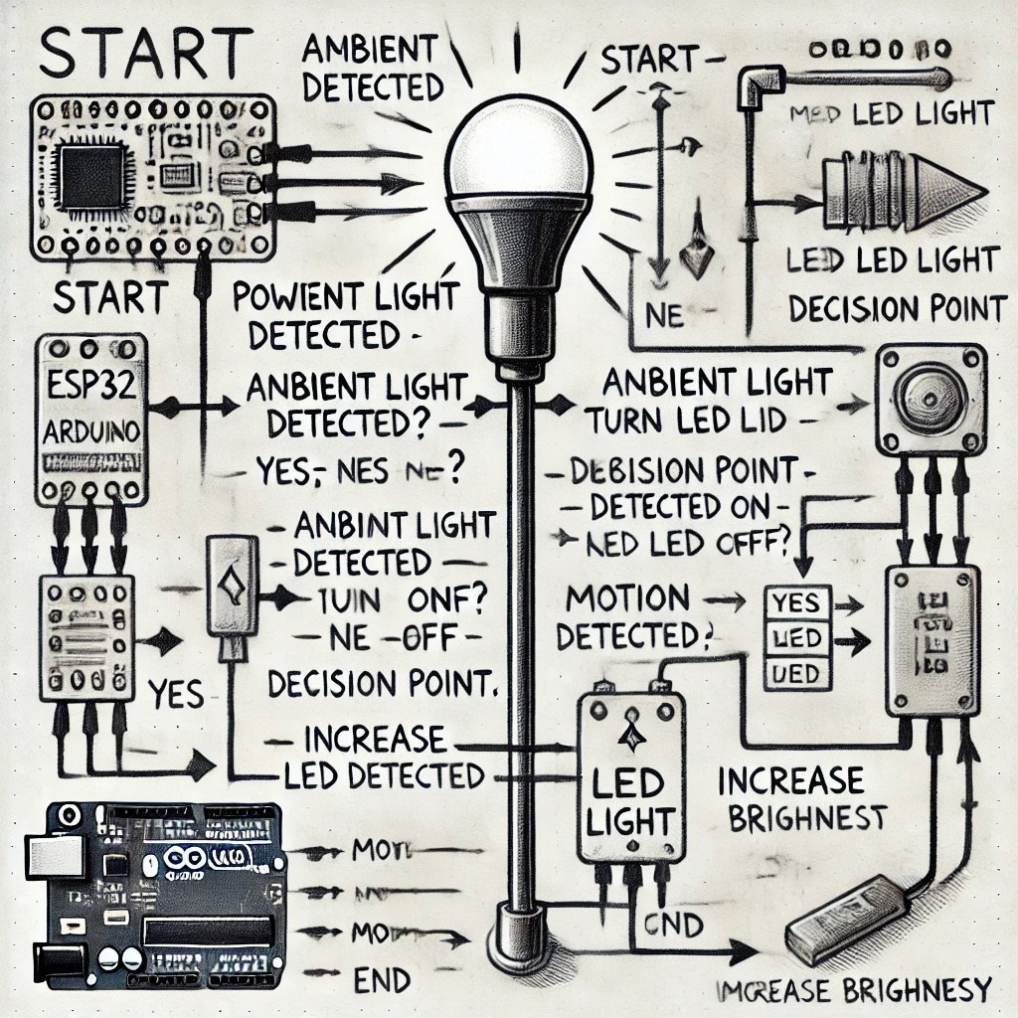
Illustration Image

Slide 10
Arduino Code ..contd
int ldrPin = A0; // LDR connected to Analog pin A0
int pirPin = 2; // PIR sensor connected to digital pin 2
int lightPin = 13; // LED light connected to digital pin 13
void setup() {
pinMode(lightPin, OUTPUT);
pinMode(pirPin, INPUT);
Serial.begin(9600);
}
void loop() {
int lightLevel = analogRead(ldrPin);
int motion = digitalRead(pirPin);
if (lightLevel < 500 || motion == HIGH) {
digitalWrite(lightPin, HIGH); // Turn ON light
} else {
digitalWrite(lightPin, LOW); // Turn OFF light }
Serial.print("LDR: ");
Serial.print(lightLevel);
Serial.print(" PIR: ");
Serial.println(motion);
delay(1000);}

Slide 11
Bill of Material (BOM) and Cost Estimate
ITEM | DESCRIPTION | MANUFACTURER/SOURCE | PART# | QTY | UNIT COST | TOTAL COST
LED Street Light with solar panel | Energy-efficient, motion-activated, and brightness-adjustable lighting. |  |  | 1 | 1900 | 1900
LDR Sensor | Detects ambient light levels to control LED activation and brightness. |  |  | 1 | 150 | 150
PIR Sensor | Detects motion to adjust LED brightness for energy efficiency. |  |  | 1 | 150 | 150
Arduino | processes sensor data and controls LED operation. |  |  | 1 | 350 | 350
IP65,IP66,IP67 Sensor | Dust-tight and water-resistant sensor for harsh environments |  |  | 3 | 1500 | 4500

Slide 12
Bill of Material (BOM) and Cost Estimate
ITEM | DESCRIPTION | MANUFACTURER/SOURCE | PART# | QTY | UNIT COST | TOTAL COST
Rechargeable Battery | Stores energy to power the system during low or no power supply. |  |  | 1 | 500 | 500
Resistors & Wiring | Control current flow and connect components for stable operation. |  |  | 1 | 300 | 300
Enclosure/ Frame | Protects internal components and provides structural support. |  |  | 1 | 400 | 400
Power Backup | Battery stores energy generated by the solar panel for powering the street light at night |  |  | 1 | 8000 | 8000

Slide 13
Gantt Chart -- Project Plan
Task/Activity | Wk3 | Wk4 | Wk5 | Wk6 | Wk7 | Wk8 | Wk9 | Wk10 | Wk11
Wk start date | ✅
Wk end date |  |  |  |  |  |  |  |  | ✅
List 3 design alternatives | ✅ | ✅ | ✅
Freeze on one design |  | ✅ | ✅
Design Presentation/ Review |  |  |  | ✅ | ✅ | ✅
Detailed design, BOM, place orders |  |  |  |  |  | ✅
Implementation and Testing |  |  |  |  |  |  | ✅
Notes:
Provide a high level Project plan for developing the prototype for your selected design. Keep in mind the weekly schedule of LP201 and ensure that the completion dates are sufficiently before the LEAP deadlines!

Slide 14
Gantt Chart -- Project Plan ..contd
Task/Activity | Wk3 | Wk4 | Wk5 | Wk6 | Wk7 | Wk8 | Wk9 | Wk10 | Wk11
Wk start date | ✅
Wk end date |  |  |  |  |  |  |  |  | ✅
Demo, Open house preparation |  |  |  |  | ✅ | ✅ | ✅
Open house |  |  |  |  |  | ✅ | ✅
Closure Project Report Feedback Settling bills Returning tools/ equipment .. |  |  |  |  |  |  |  | ✅ | ✅
Notes:
Provide a high level Project plan for developing the prototype for your selected design. Keep in mind the weekly schedule of LP201 and ensure that the completion dates are sufficiently before the LEAP deadlines!

Slide 15
Open Issues
Balancing LED brightness and energy consumption.
Fine-tuning PIR and LDR sensors to reduce false triggers.
Ensuring stable remote monitoring and control.

Slide 16
References
https://www.electroduino.com/smart-street-light-system-using-ir-sensor-and-arduino/?utm_source=chatgpt.com
https://www.slideshare.net/ChethanMp7/smart-street-light-system-248536629?utm_source=chatgpt.com

